Slide 1

Organizational Aspects of Data Management
www.pdbmbook.com

Slide 2
Introduction
Data Management
Roles in Data Management

Slide 3
Data Management
Catalogs and the Role of Metadata
Metadata Modeling
Data Quality
Data Governance

Slide 4
Catalogs and the Role of Metadata
Just as raw data, also metadata is data that needs to be properly modeled, stored and managed
Concepts of data modeling should also be applied to metadata
In a DBMS approach, metadata is stored in a catalog (a.k.a. data dictionary, data repository), which constitutes the heart of the database system
  can be part of a DBMS or standalone component

Slide 5
Catalogs and the Role of Metadata
The catalog provides an important source of information for end users, application developers, as well as the DBMS itself
Catalog should provide:
  an extensible metamodel
  import/export facilities
  support for maintenance and re-use of metadata
  monitoring of integrity rules
  facilities for user access
  statistics about the data and its usage for the DBA and query optimizer

Slide 6
Metadata Modelling
A metamodel is data model for metadata
A database design process can be used to design a database storing metadata
Design a conceptual model of the metadata: EER model or UML model

Slide 7
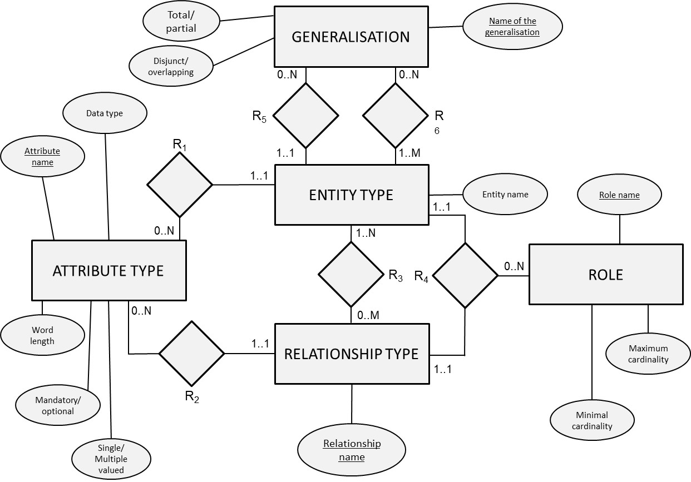
Metadata Modelling

Slide 8
Data Quality
Data quality (DQ) is often defined as ‘fitness for use’
  data of acceptable quality in one decision context may be perceived to be of poor quality in another
Data quality determines the intrinsic value of the data to the business
  GIGO: Garbage In, Garbage Out
  E.g., obsolete addresses
Poor DQ impacts organizations in many ways
  operational versus strategic level

Slide 9
Data Quality
DQ is a multi-dimensional concept in which each dimension represents a single aspect or construct, comprising both objective and subjective perspectives
A DQ framework categorizes the different dimensions of data quality
Example: Wang et al. (1996)
  4 categories: intrinsic, contextual, representation, access

Slide 10
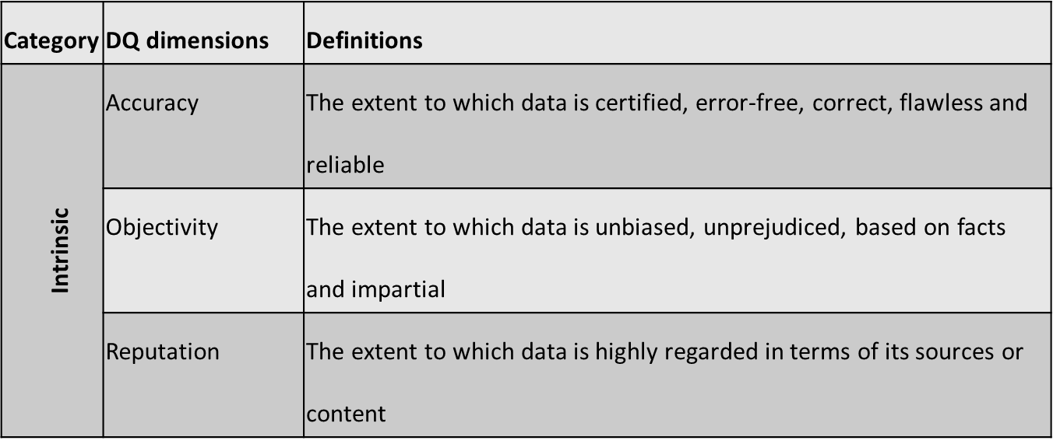
Data Quality

Slide 11
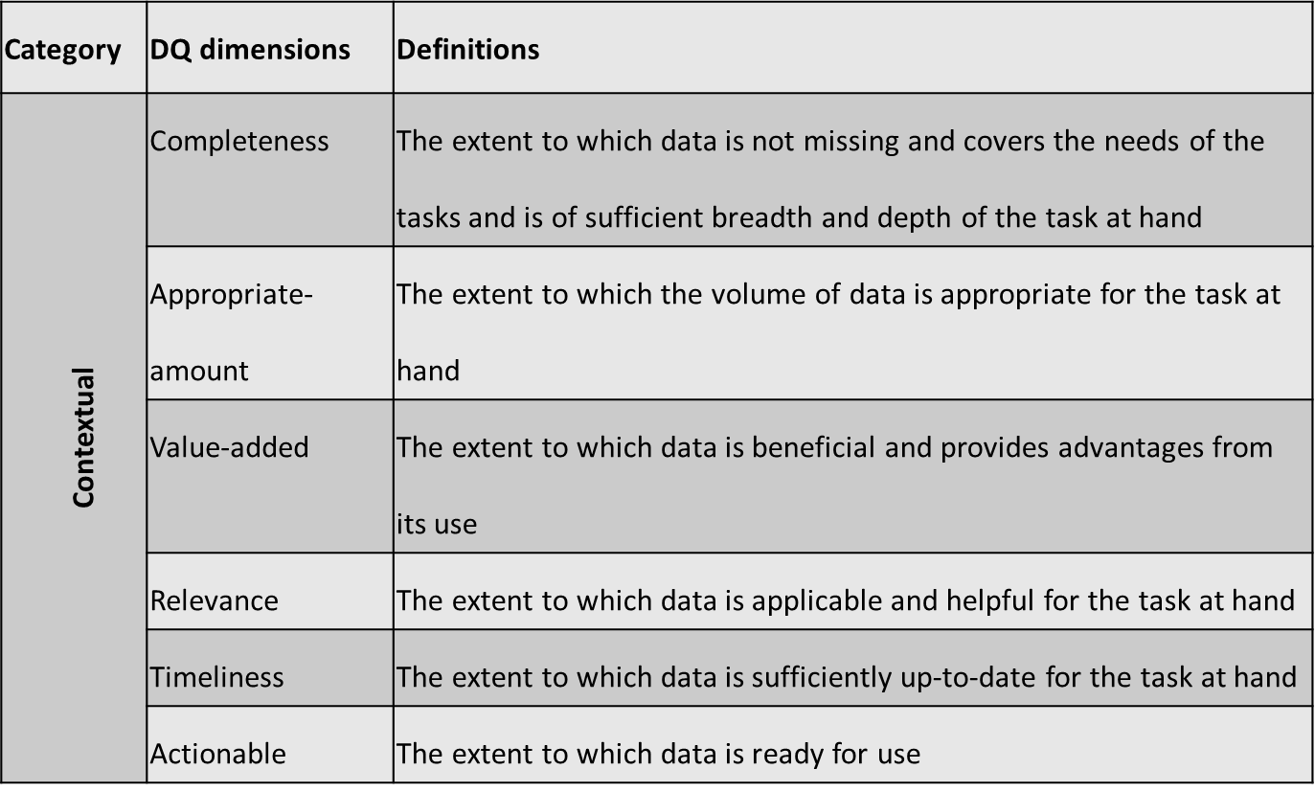
Data Quality

Slide 12
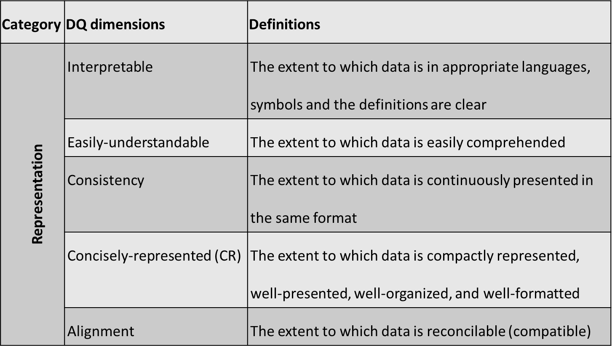
Data Quality

Slide 13
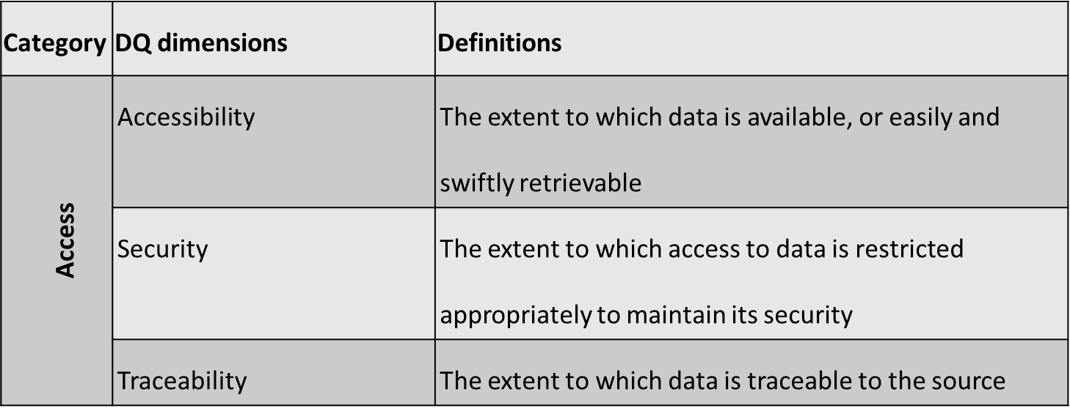
Data Quality

Slide 14
Data Quality
Accuracy refers to whether the data values stored for an object are the correct values
  often correlated with other DQ dimensions
Completeness can be viewed from at least 3 perspectives:
  schema completeness: refers to the degree to which entity types and attribute types are missing from the schema
  column completeness: refers to the degree to which there exist missing values in a column of a table
  population completeness: refers degree to which the necessary members of a population are present or not

Slide 15
Data Quality
The consistency dimension can also be viewed from several perspectives:
  consistency of redundant or duplicated data in one table or in multiple tables
  consistency between two related data elements
  consistency of format for the same data element used in different tables

Slide 16
Data Quality
The accessibility dimension reflects the ease of retrieving the data from the underlying data sources
  often involves a trade-off with security

Slide 17
Data Quality
Common causes of bad data quality are:
  multiple data sources: multiple sources with the same data may produce duplicates; a problem of consistency.
  subjective judgment in data production: data production using human judgment can result in biased information; a problem of objectivity.
  limited computing resources: lack of sufficient computing resources may limit the accessibility of relevant data; a problem of accessibility.
  volume of data: Large volumes of stored data make it difficult to access needed information in a reasonable time; a problem of accessibility.
  changing data needs: data requirements change on an ongoing basis; a problem of relevance.
  different processes updating the same data; a problem of consistency.
Decoupling of data producers and consumers contributes to data quality problems

Slide 18
Data Governance
To manage and safeguard data quality, a data governance culture should be put in place assigning clear roles and responsibilities
  manage data as an asset rather than a liability
Different frameworks have been introduced for data quality management and data quality improvement
  examples: Total Data Quality Management (TDQM), Total Quality Management (TQM), Capability Maturity Model Integration (CMMI), ISO 9000, Control Objectives for Information and Related Technology (CobiT), Data Management Body of Knowledge (DMBOK), Information Technology Infrastructure Library (ITIL) and Six Sigma

Slide 19
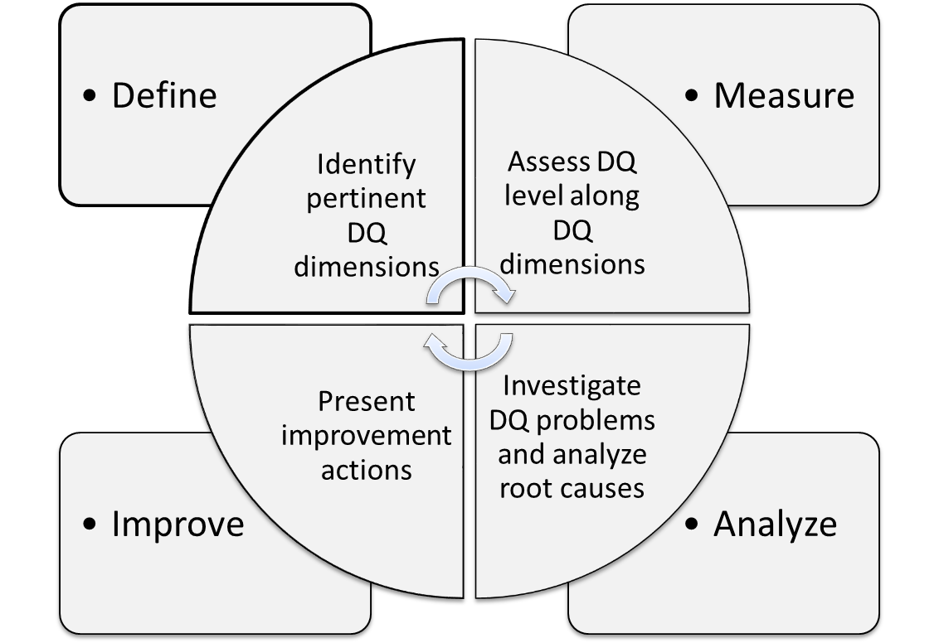
Data Governance
Wang (1998)

Slide 20
Data Governance
Annotate the data with data quality metadata as a short term solution
  can be stored in the catalog
  E.g., credit risk models could incorporate an additional risk factor to account for uncertainty in the data
Unfortunately, many data governance efforts (if any) are mostly reactive and ad-hoc

Slide 21
Roles in Data Management
Information Architect
Database Designer
Data owner
Data steward
Database Administrator
Data Scientist

Slide 22
Roles in Data Management
Information Architect (a.k.a. Information Analyst)
  responsible for designing the conceptual data model
  bridges the gap between the business processes and the IT environment
  closely collaborates with the database designer who may assist in choosing the type of conceptual data model (e.g. EER or UML) and the database modeling tool

Slide 23
Roles in Data Management
Database Designer
  translates the conceptual data model into a logical and internal data model
  also assists the application developers in defining the views of the external data model
  defines company-wide uniform naming conventions when creating the various data models

Slide 24
Roles in Data Management
Data owner
  has the authority to ultimately decide on the access to, and usage of, the data
  could be the original producer of the data, one of its consumers, or a third party
  should be able to insert or update data
  can be requested to check or complete the value of a field

Slide 25
Roles in Data Management
Data steward
  DQ experts in charge of ensuring the quality of both the actual business data and the metadata
  perform extensive and regular data quality checks
  can initiate corrective measures or deeper investigation into root causes of data quality issues
  can help design preventive measures (e.g. modifications to operational information systems, integrity rules)

Slide 26
Roles in Data Management
Database Administrator (DBA)
  responsible for the implementation and monitoring of the database
  closely collaborates with network and system managers
  also interacts with database designers
Data scientist
  responsible for analyzing data using state-of-the-art analytical techniques to provide new insights into e.g. customer behavior
  has a multidisciplinary profile combining ICT skills with quantitative modeling, business understanding, communication, and creativity

Slide 27
Conclusions
Data Management
Roles in Data Management

Slide 28
More information?
www.pdbmbook.com

